Slide 1



Enhancing Conformational Priors for Small Rings in
Structural Biology through Computational Energy Analysis
Statistical learning from simulation and observations with application to the protein ligand structures
Lala Ibadullayeva
MSERA, IMBB, Baku, Azerbaijan
lala.ibadullayeva@gmail.com
23 Dec, 2025, Baku, Azerbaijan

Slide 2
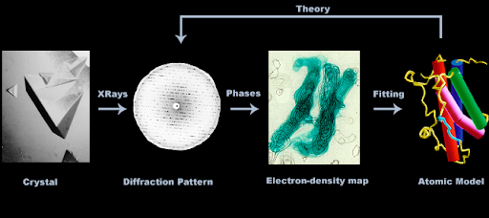
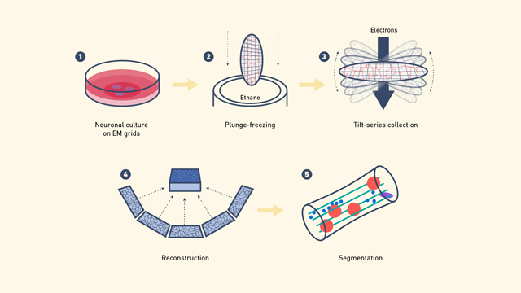
Derivation of Macromolecular atomic structure models
Macromolecular crystallography
Main Methods:
Crystallography & Cryo-Electron Microscopy: Can result in good models
Issues: Often produce sparse and noisy data, making data-only derived models unreliable
Solution - use Bayesian Statistics:
Combines likelihood (observation model) with prior probability (existing knowledge).
Enhances reliability of molecular models.
Stereochemical Parameters:
Bond lengths and angles: Well-established, widely used in structural biology software.
Conformational angles: Challenging due to multimodality and environmental dependence.
Cryo-electron microscopy

Slide 3
Challenges and Study Approach
Conformational Angle Challenges:
Torsion angles in small-ring systems: Complex due to ring closure constraints.
Constraints reduce independent variables leading to interdependencies.
Study Objective:
Develop a framework to organize and classify small-ring conformations.
Focus: Statistical models.
Methodology:
Combine computational simulations (RDKit, PySCF) with experimental data from the Crystallography Open Database (COD).
Aim: Integrate knowledge to improve modelling of macromolecules

Slide 4
Aim of the Research
Overall Objective:
To identify ring classes based on involved atoms and their covalent environment
To calculate the possible conformations for each ring class with their respective energies.
To identify a relationship between simulations and observational data.
Details:
Use existing observational data to build statistical models.
Use computational tools to augment observed data
Applications: (future)
Conformational analysis of ligands with small rings, e.g. carbohydrates.
More accurate analysis of RNA/DNA structures.
Validate and improve atomic models in the PDB

Slide 5
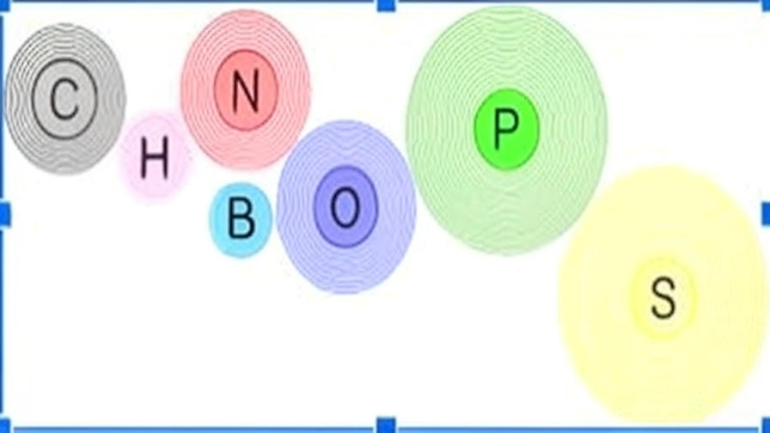
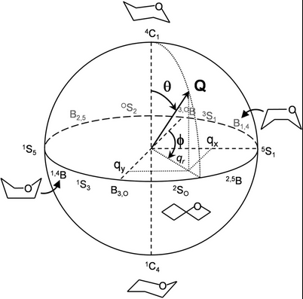
Methodology Overview
Workflow Summary:
Data acquisition from COD (≤1.0 Å)
Ring extraction & classification
Computation of Cremer–Pople parameters
SMILES conversion for simulations
Conformational sampling (RDKit)
Energy evaluation (DFT & HF using PySCF)
Cremer-Pople mapping rings to sphere

Slide 6
Methodology: Conformer Generation and Visualisation
Conformer Generation and Optimisation
RDKit: Generation of molecular structures from SMILES format.
MMFF and UFF Methods: Initial optimisation of molecular structures and calculation of their energies.
Energy Calculation Methods
Hartree-Fock Method: Precise calculation of molecular energies.
Density Functional Theory (DFT): Faster and accurate energy analysis.
Boltzmann Distribution
Identification of dominant conformers and calculation of relative probabilities.
Visualisation
Visualisation Tools: Conformers depicted in 3D using py3Dmol.
Conformer Generation from SMILES Format:
RDKit employed to generate conformers.
Geometry optimisation was performed for each conformer.

Slide 7
Ring Selection Criteria
Filters Applied to COD Dataset:
High-resolution X-ray structures
Finite and well-defined molecules
Rings of 4–6 atoms, non-flat
Composed of C, N, O, P, S, B
Outcome:
523,000 initial crystal structures
235,000 passed the filters
157,000 contained non-aromatic rings
116,000 was the extracted number of 4-6 membered rings

Slide 8
Ring Classification
Classifying by Atomic Connectivity:
For COD :
Total: 7,600 distinct classes
Only 20 classes had >500 observations
Cremer–Pople Parameters:
Quantify ring conformation parameters
Describe ring conformations independently of its size

Slide 9
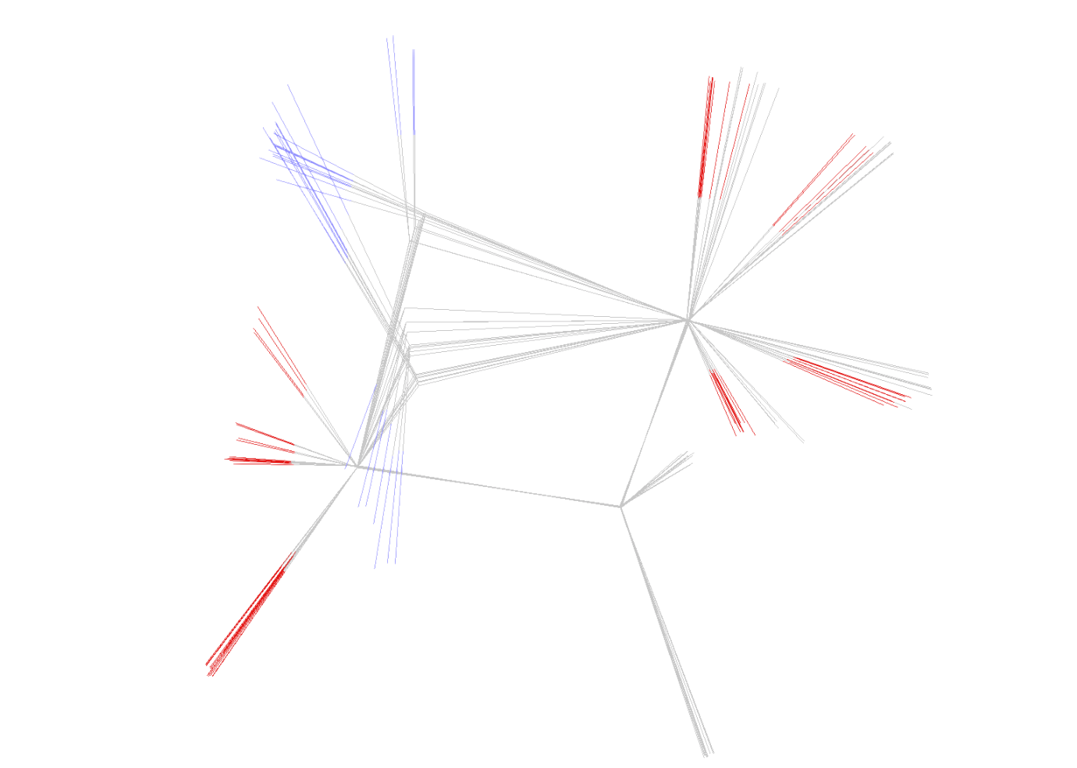
Structural overlay of low-energy conformers
Here we show an overlay of the lowest-energy conformers. The conformers are aligned using selected ring atoms in order to make the structural differences more clearly visible.
Key observation: Although the conformers have nearly identical energies, they exhibit noticeable differences in ring puckering and substituent orientations.
This demonstrates that energy values alone are not sufficient to uniquely define the conformation of a ring system.

Slide 10
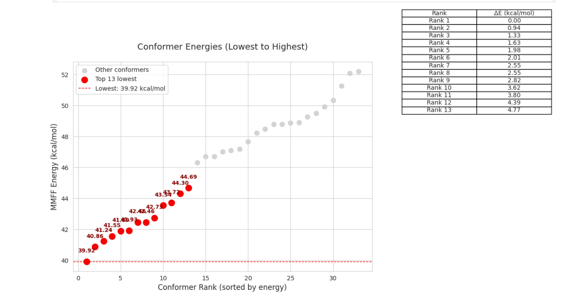
Energy ranking of generated conformers
This plot shows the MMFF force-field energies of all generated conformers, sorted from lowest to highest energy.
Each point represents a unique conformer obtained from RDKit-based conformer generation and geometry optimisation.
The lowest-energy conformers are highlighted in red, while higher-energy conformers are shown in grey.
Relative energies (ΔE) are reported with respect to the global minimum, which is set to 0 kcal/mol.
The small energy differences among the lowest-ranked conformers indicate the presence of multiple energetically accessible conformations.

Slide 11
Acknowledgement
Garib Murshudov (IMBB, MRC-LMB)
Irada Huseynova (IMBB)
IMBB (Baku, Azerbaijan)
Kave Babai
Sahib Babaliyev
Humay Mammadli
Guman Garayev - MegaSec, Baku, Azerbaijan
Fei Long - MRC-LMB, Cambridge,UK
All colleagues from IMBB

Slide 12

Thank you for joining us :)

